Slide 1
PUSL 2026 - Computer Networks
Lecture 4 – Network Implementation Process
Chamara Disanayake
Senior Lecturer
Department of Network and Security

Slide 2
What We have Discussed So Far?
Evolution of Data Communication
Requirements for Computer Networks
  99% of the computer applications are Network Applications
Networking Concepts
  Models, Topologies
Network Media – Guided media, unguided media
Network Equipment/Devices
  Active devices/Passive device, End devices/intermediate devices
As you know about Computer Networks, Can you design a network for a customer/customer organization?

Slide 3
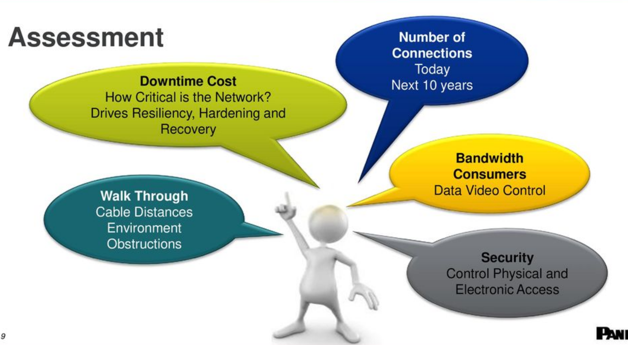
Network Implementation Process
Implementing a network to deliver organizational requirements is a challenging task
Planning the key to success
  Identify the current requirement
  Match with current technologies
  Check the affordability
  Design the network/system
  Identify the process
    Follow the process
  Implementation
  Testing

Slide 4

Task as a Network Designer
Network designers' main responsibility is to identify the company's network requirements and design a network to meet those needs.
They design and submit plans for the network to management. Designers make any updates and upgrades to software and hardware needed.
The designs goals
  The objective of network design is to satisfy data communication requirements while minimizing expense
Different choice (designs/topologies/hardware/software).
Needs an approach to reach to the goal.
Always better to follow a Process/Models to reduce the risk.

Slide 5
The Design Goals
Functionality
  Proper functionalities implemented
Adaptability
  Successful integration of new technology into the business
Scalability
  Ability of IT systems continue to function properly when changed in size or volume
Manageability
  Ability of controlling the IT system/services
Cost effectiveness
  Whether the IT cost gain a profit to the business

Slide 6
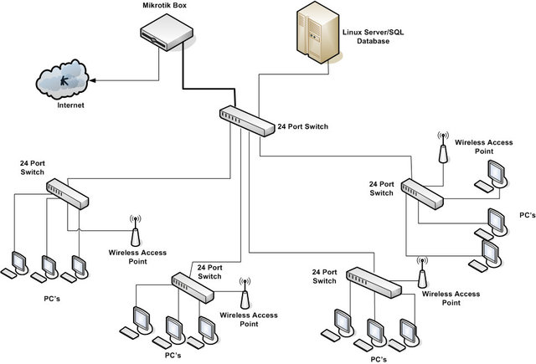
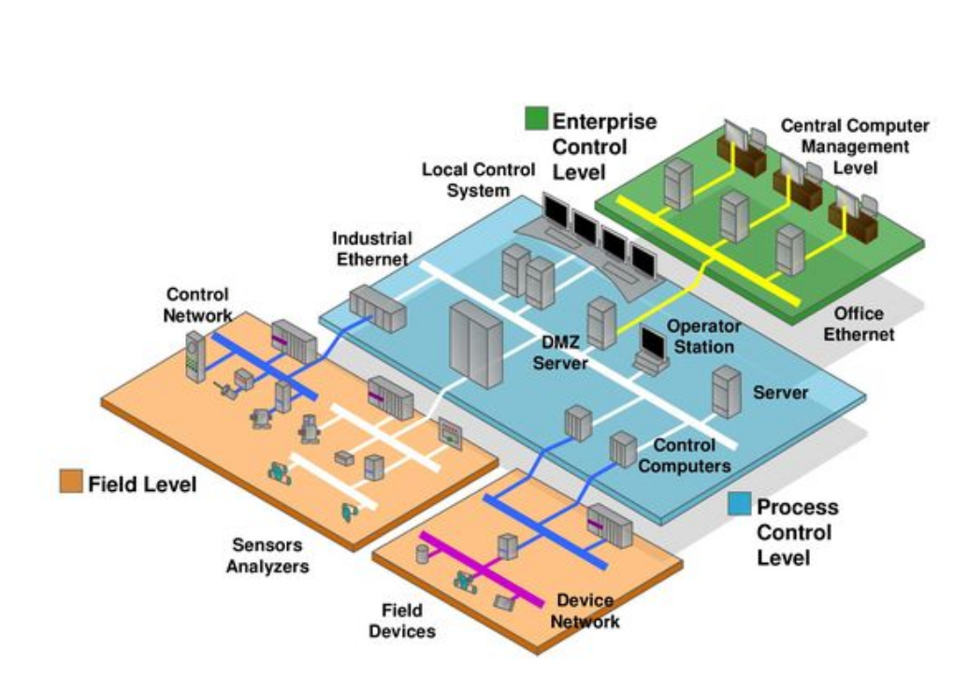
The Key Designing/Plans of a Network
Logical Design
  Logical design explains the logic between the input and output design
Physical Infrastructure Design
  The physical infrastructure design includes deciding on the network, data paths, locations for equipment.

Slide 7
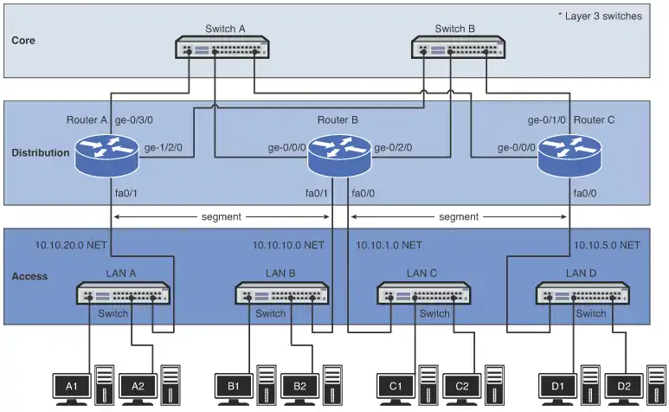
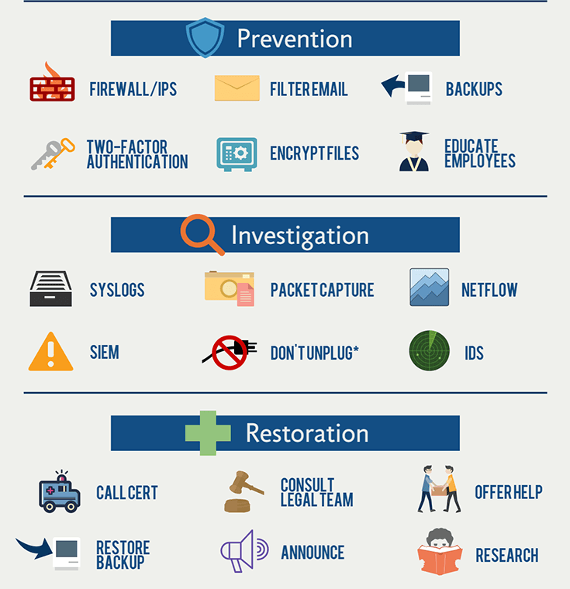
The Key Designing/Plans of a Network
Routing Plan
  Subnetting, Gateways, Routing plans
Network Management design
  How/where the network management done
Security Design
  Setting security controls (HW/SW controls, physical controls etc)
DR and fault handling Plan
  Plan for the disaster
Upgrade /maintenance and Phase out plan

Slide 8
A Good Design
Must deliver the required servicers.
Deliver acceptable throughput and response time.
Reliable.
Expandable without major redesigning
Easy to manage and maintain
Within a specific budget
Well documented

Slide 9
Design Choices
The Balance of distribution
The Level of transparency
Security implementation
Connectivity Technologies

Slide 10
Current Expectations from Networks
Functionality and Speed
Mobility and flexibility
Security
Resiliency ( fault tolerance)
Business continuity( continue the business after calamities) /disaster recovery.
Must deliver all the business requirements within the budget and time.
Minimum disruptions during implementations.

Slide 11
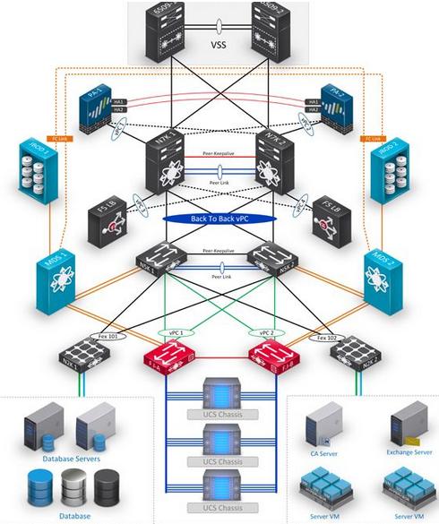
Technological Trends
Implementing the Network with supported technologies
  Segmenting / Extending /Expanding the network
  Enable Remote access/BOYD
  Increase Reliability / Availability / Quality
What are the enabling technologies
  Network Improvements - VLAN, VPN, SDN
  Reliability/Availability - Network redundancy with multi homing, Cloud services, NFV, Virtualization platforms, Backup and DR / CDN
  Quality – Improved services with high-speed networks – 5G, SD WAN

Slide 12
What are the Constrains
Budget
Skillful Staff
Schedule/Time
Policies and legal requirements
Internal and external Politics
Organizational Socioeconomic conditions.

Slide 13

Challenge the Challenges
Implementing and managing a network which deliver desired organizational goal is a challenge.
A proper Approach is required to overcome the challengers and reach the goal.
  Design and Implementing a network can be compared with building a house.
    You need to find the requirements and budget
    You need to prepare a plan and get approvals
    Most importantly, it is required to adhere to standards/best practices
Good to Read : https://www.auvik.com/franklyit/blog/network-design-best-practices/

Slide 14
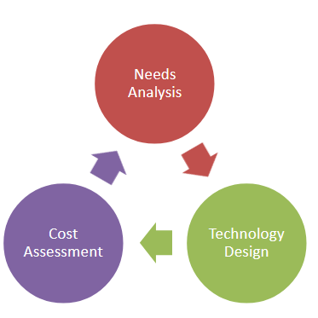
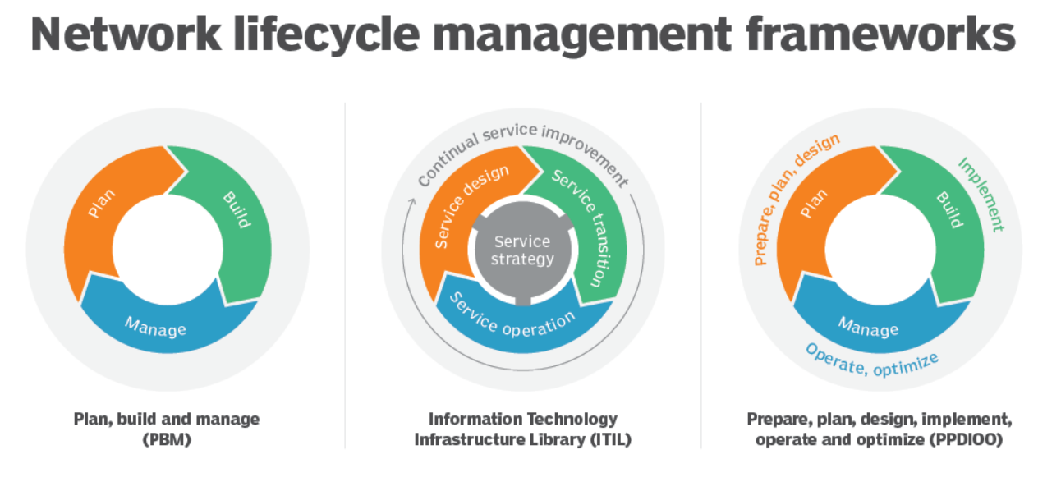
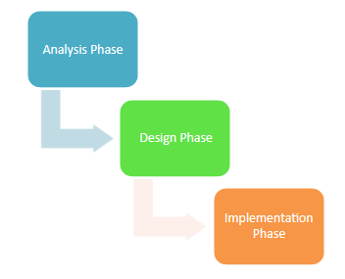
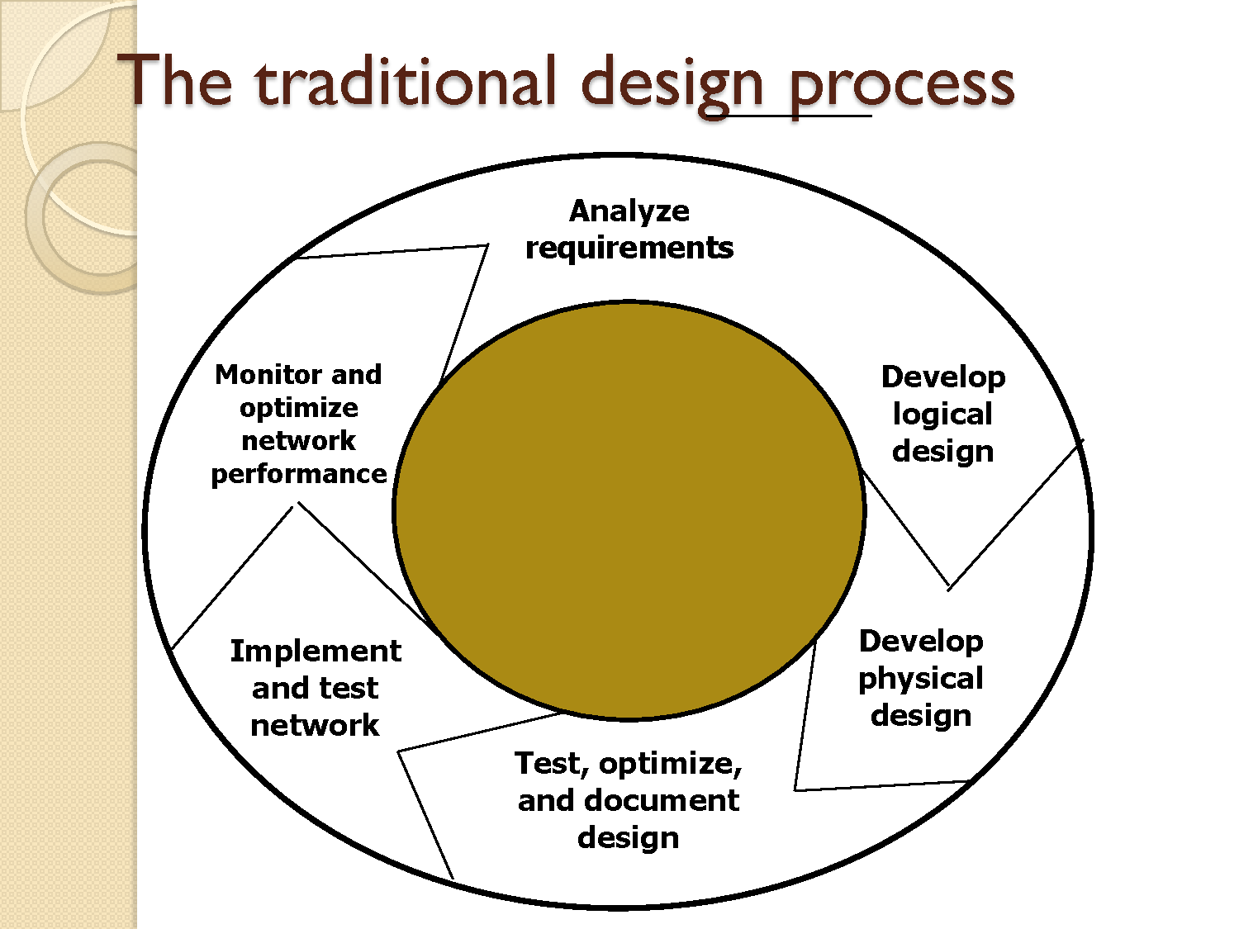
Frameworks
Traditional Analytical method (top-down approach)
PPDIOO framework (CISCO)

Slide 15
Traditional Analytical method (Top Down approach)
The traditional network design process follows a very structured systems analysis and design process similar to that used to build application systems.
First, the network analyst meets with users to identify user needs and the application systems planned for the network.
Second, the analyst develops a precise estimate of the amount of data that each user will send and receive and uses this to estimate the total amount of traffic on each part of the network. Third, the circuits needed to support this traffic plus a modest increase in traffic are designed and cost estimates are obtained from vendors.
Finally, 1 or 2 years later, the network is built and implemented.

Slide 16
Traditional Approach - Limitations
This traditional process, although expensive and time consuming, works well for static or slowly evolving networks.
  Unfortunately, networking today is significantly different from what it was when the traditional process was developed.
Three forces are making the traditional design process less appropriate for many of today’s networks.
First, the underlying technology of the client and server computers, networking devices, and the circuits themselves is changing very rapidly.
Second, the growth in network traffic is immense.
Third, cost factor of hardware, software and HR

Slide 17
PPDIOO method (CISCO)
This methodology is composed by six phases closely related:
  prepare, plan, design, implement, operate, optimize. As show in this figure, the PPDIOO lifecycle phases are separate, yet closely related
Why use the PPDIOO model?
  Lowering the total cost of network ownership
  Improving business agility
    an organization’s ability to respond rapidly to changing business or market conditions
  Increasing availability (HA) with proper Disaster Recovery (DR)

Slide 18
Identification of Requirements of a Network

Slide 19
Phase 1 Analyzing the requirements
Identify the business goals.
Getting the Requirements
Collect background of existing networks ( traffic plots /graphs/logs and projections)
Analyze them and build priority Metrix.
Analyze the technical options and set tradeoffs .

Slide 20
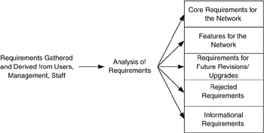
Requirements
Needs to Identify the requirements before Planning and designing
The process involve.
  Identify requirements
  Gather all requirements
  Classification and prioritized of requirements.
  Verify requirements and Priority
  Address them accordingly in the designing

Slide 21
Identification of Requirements
Requirements can come from many aspects of the network system
  Consider the Computer Network is like the Road Network
  User Requirements
  Application Requirements
  Device Requirements
  Network Requirements
  Other Requirements
  Technological Trends

Slide 22
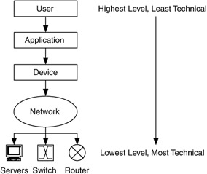
Requirements Analysis
How do we describe requirements for a network?
  Users are the main key .
  Difficult to provide all the requirements.
  Must address common ones first.
  Speed is a common topic but depend on multiple factors from user perception to hardware.

Slide 23
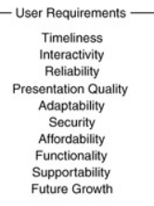
User Requirements
The term user represents primarily the end users of the system
  It can be expanded to include everyone involved in the system, such as network and system administrators and management.
User requirements is the set of requirements gathered or derived from user input and is what is needed by users to successfully accomplish their tasks on the system.

Slide 24
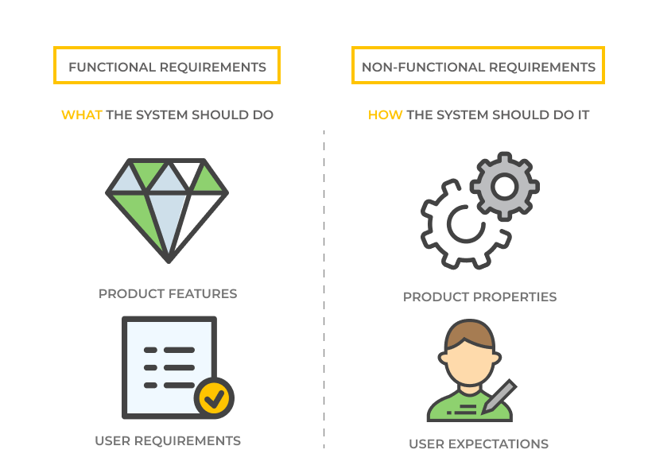
Application Requirements
What types of apps are we using?
  Mission-critical
  Rate-critical
  Real-time and/or interactive (Delay Sensitive)
How sensitive are apps to RMA (reliability, maintainability, availability) of the network?
What capacity is needed?
What delay time is acceptable?

Slide 25
Application Requirements
What groups of apps are being /will be used ?
  Web and related servicers
  Teleservice – VOIP, teleconference, telepresence, AOIP
  Operations, admin and maintenance of Network itself (DNS, SMTP, SNMP,NTP)
  Client-server base special/ business applications– ERP, SCM, CRM
  Visualization and simulation
  Command and control - remote devices
  Distributed computing, Big data or grid applications.
  Bulk data transport – FTP

Slide 26
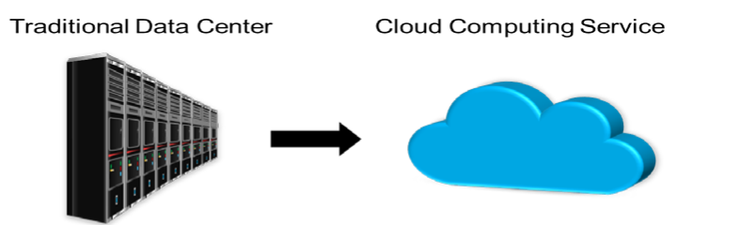
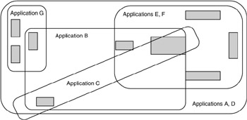
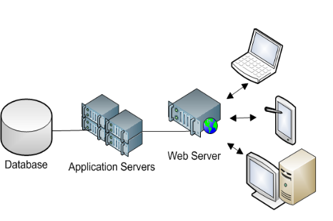
Application Requirements
Where are the apps hosted?- Cloud, Data center, Own server network
  user base/customer base
What is the relationship between Apps.
Time based behaver of apps.- off site backups , sync patterns, updates.

Slide 27
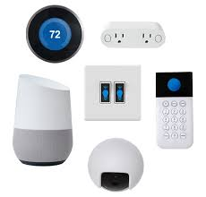
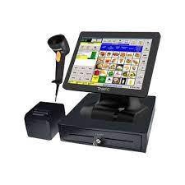

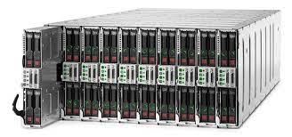

Device Requirements
What kinds of devices are on your network?
  Generic computing devices (PCs, Macs, laptops, handheld computers, workstations)
  Servers (all flavors of server – file, print, app, computation)
  Specialized devices (supercomputers, massively parallel servers), data collection systems (POS terminals), industry-specific devices, networked devices (cameras, tools, access control, medical equipment's ) VOIP ATMs, IOT, etc.

Slide 28
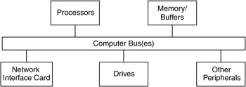
Device Requirements
We want an understanding of the device’s performance – its ability to process data from the network
  Device I/O rates, network dependency, interfacing technology and speeds
  Delay time for performing a given app function

Slide 29
Device Requirements
Performance results from many factors
  Storage performance, that is, flash, disk drive,
  or tape performance
  Processor (CPU) performance
  Memory performance (access times)
  Bus performance (bus capacity, width and frequency)
  OS performance (effectiveness of the protocol stack and APIs)
  Device driver performance

Slide 30
Network Requirements
Network requirements are the requirements for interacting with the existing /other network(s) and network management concerns
Most networks may need to integrate with existing networks
What is the plan for the future evolution of the network?
What will happen to product specific protocols or technologies if the network become heterogeneous.

Slide 31
Network Requirements
Issues with network integration include
  Scaling dependencies – how will the size of the existing network affect the new one?
    Will the existing network change structure, or just add on a new wing?
  Location dependencies – interaction between old and new networks could change the location of key components
  Performance constraints – existing network could limit performance of the new one

Slide 32
Network Requirements
  Network, system, and support service dependencies
    Addressing, security, routing protocols and network services
      DNS, DHCP
  Interoperability dependencies
    Changes in technology or media at the interfaces between networks need to be accounted ,Implementation of QoS.
  Network obsolescence/facing out of technologies and compatibility
    What will be the impact if a technology or protocall become obsolete during transition?

Slide 33
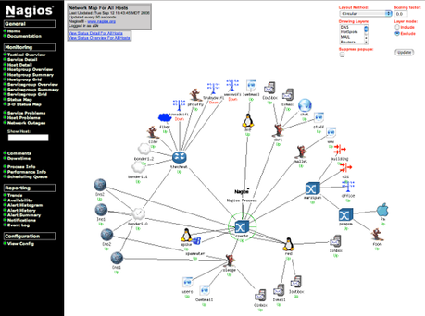
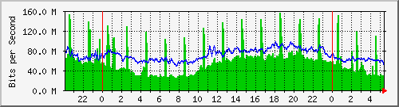
Network Requirements
Network Administration ,Management and security need to be addressed throughout development.
  How will the network be monitored for events?
    Thresholds and alerts.
  What factors to be monitored for network performance?
    What is the hierarchy for management data flow?
  Network configuration management
  Troubleshoot and Event management.

Slide 34
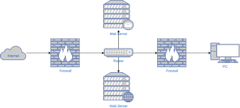
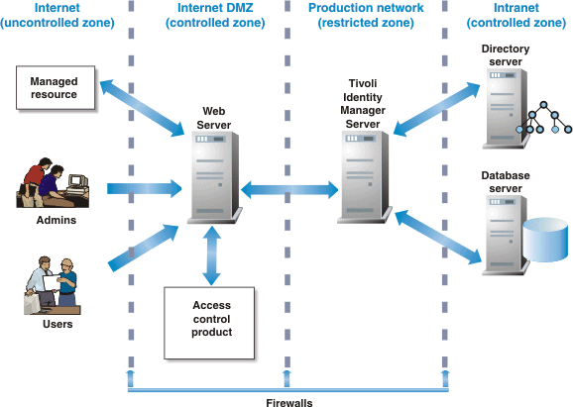
Network Requirements
Security of the network.
  What is the approach on security.
  How to secure end point.
Addressing the application level controls.
Zones with different security levels.
Bandwidth Vs filtering?

Slide 35
Other Requirements
Requirements can come from other outside sources –Customers, business partners, legal requirements, Organization (enterprise) requirements, etc.
Additional requirements can include
  Operational suitability – how well can the customer configure and monitor the system?
  Supportability – how well can the customer maintain the system?
  Conformity to standards and security

Slide 36
How to prioritized the requirements
What factors to be considered
The requirement VS cost to address.
Business priority.
Can the requirement to be address in future with minimum impact.

Slide 37
References
Network Analysis, Architecture and Design, Second Edition (The Morgan Kaufmann Series in Networking)
https://flylib.com/books/en/2.809.1.25/1/

Slide 38
Session Break
Session break from 10.45am – 11.00am

